Slide 1
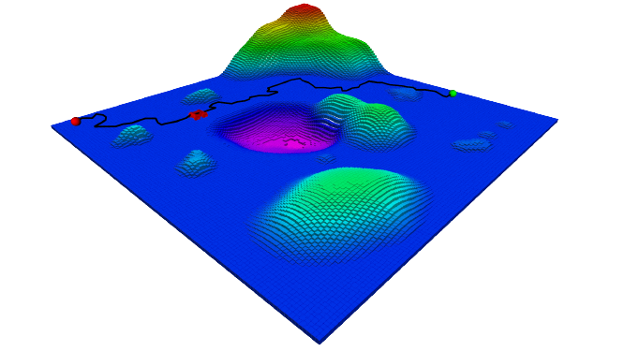
^{ENPM661 - Project 5}
Probabilistic Road Map mixed Artificial Potential Field Path Planning for Non-Holonomic Robots in Dynamic and Off-Road Terrain
Team:- Pratik Bhujbal UID: 117555295
- Mohammed Maaruf Vazifdar UID: 117509717
- {pbhujbal, maaruf98}@umd.edu
GitHub: https://github.com/Prat33k-dev/PRM-Blended-Potential-Field-Path-Planning

Slide 2

Probabilistic Roadmap Path Planning
The Probabilistic Roadmap (PRM) Planner is a motion planning algorithm in robotics, which solves the problem of determining a path between a starting configuration of the robot and a goal configuration while avoiding collisions.
Advantages:
No dimensional limitation.
Low computational complexity.
Limitations:
Poor results in narrow pathways.

Slide 3
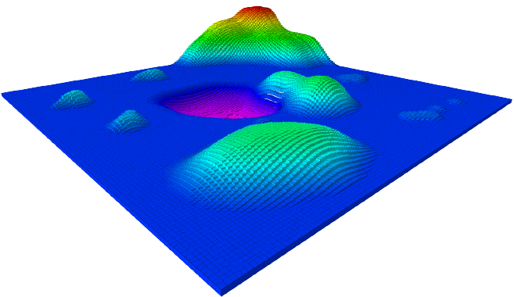
Potential Field Path Planning
Artificial Potential Field (APF) algorithm considers robot as a point under the influence of field where repulsive forces are generated by the obstacles and goal generates attractive force towards which the robot is attracted.
Advantages:
No dimensional limitation.
Simple and suitable for real-time application due
to its fast computation time.
Limitations:
Failure to find path with obstacles near goal.
Often gets trapped in local minima.

Slide 4
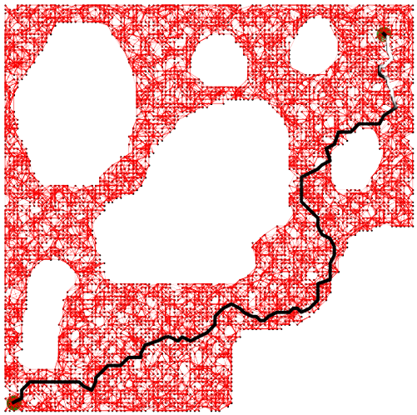
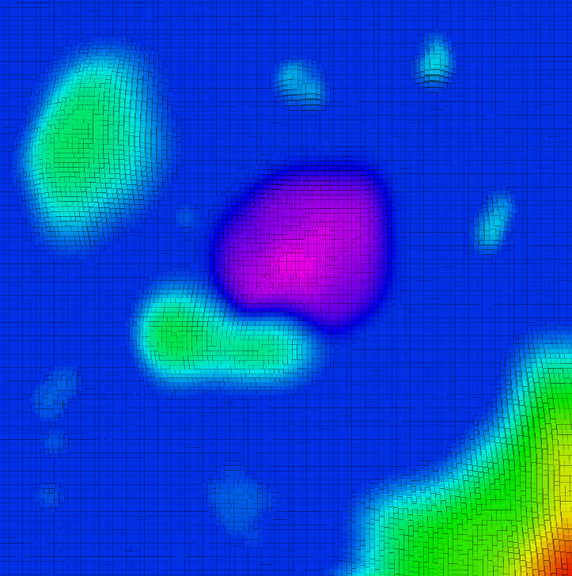
Why Combine PRM with APF?
Improved performance of PRM by ensuring higher density of sampling points near obstacles.
Facilitates dynamic environments by local reconstruction of roadmap instead of generating the whole graph again.
+
=

Slide 5


Distribution of Sampling points using Adaptive solution
Repulsive potential:
Number of sampling points N_{pts}:
N_{pts} = α . DM
where, α is the coefficient of the working space,
DM is ratio of average potential in the map and average potential in the map with full of obstacles.
Regional sampling strategy

Slide 6
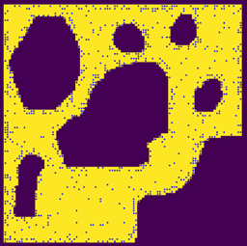
PRM vs PRM-APF blended
4.91

Slide 7
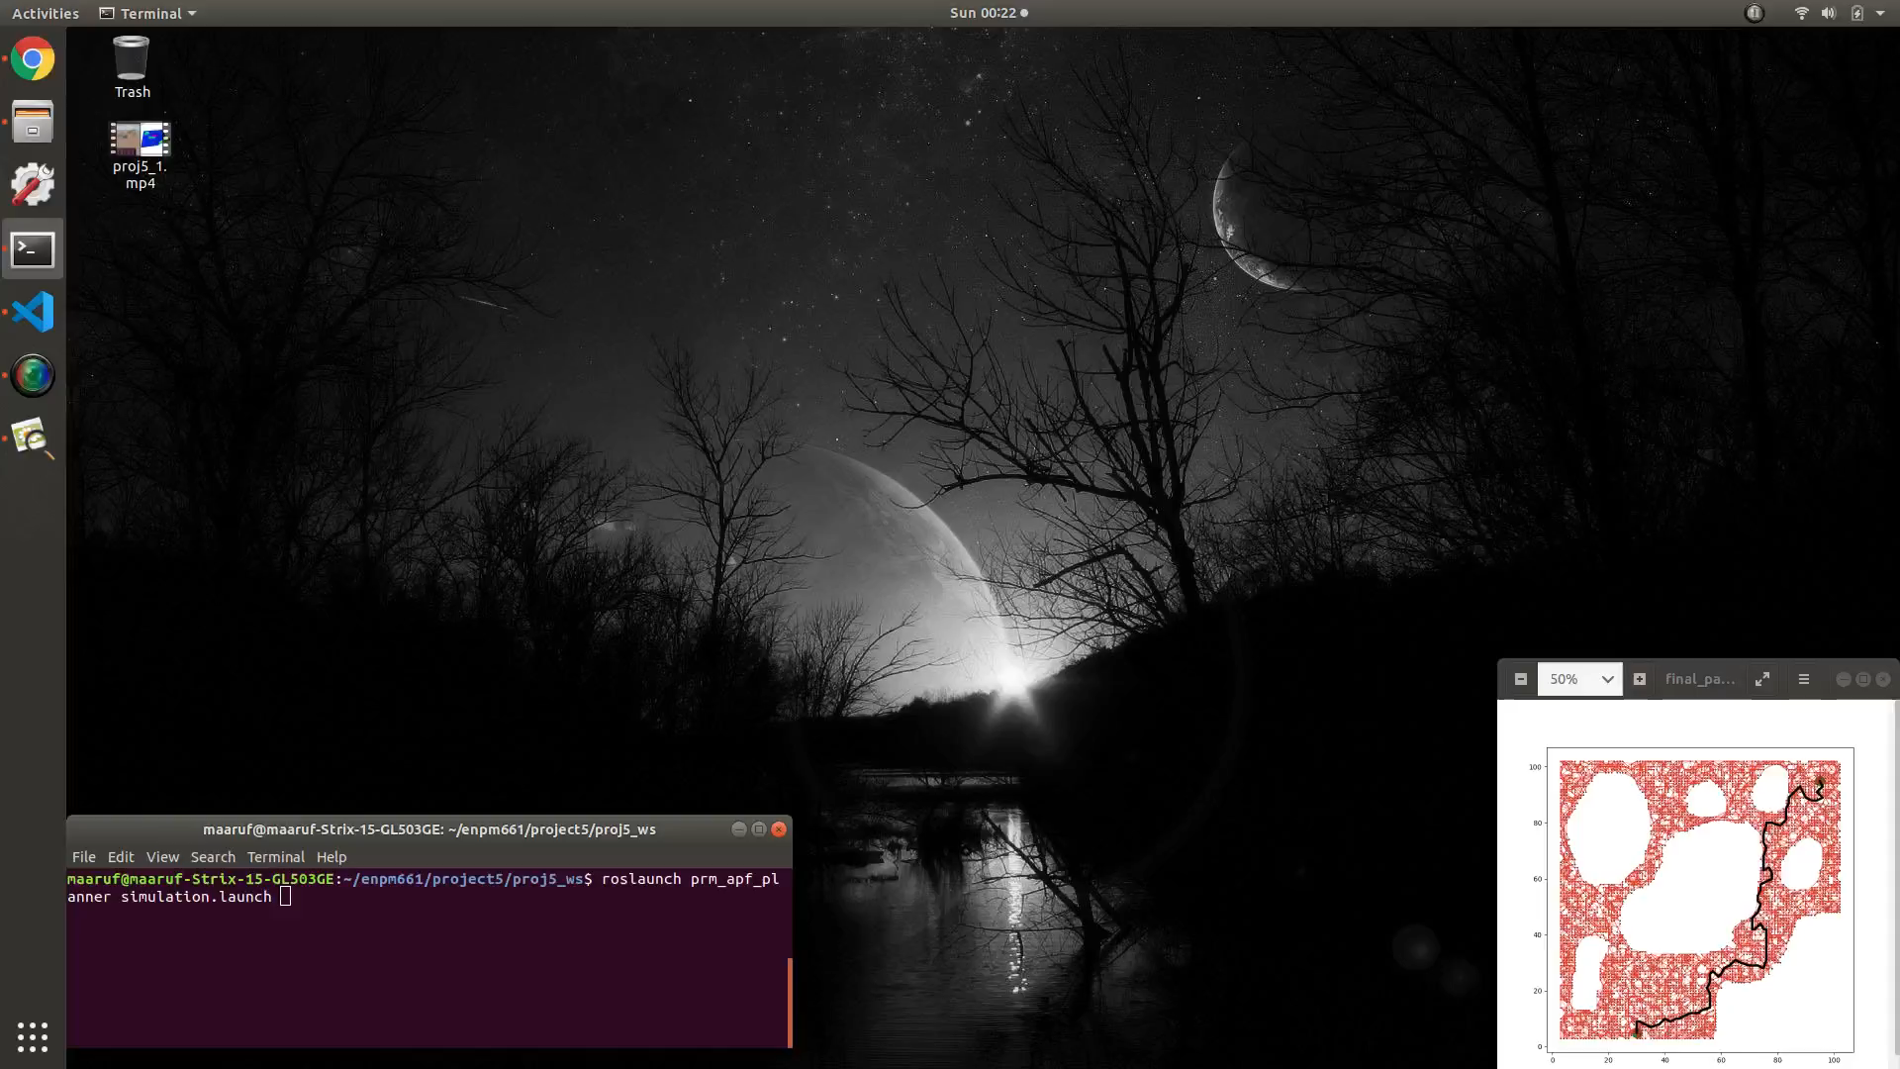
Demonstration Video
4.91

Slide 8
Conclusion
PRM-APF blended algorithm is implemented for the path planning of mobile robot that improves the graph connectivity for narrow pathways resulting in better paths for the robot. Based on the the obstacle space and free space, the algorithm determines the number of PRM Sampling Points required for optimal path planning.
Future Works
Optimize paths for robot in based on length, clearance and smoothness can be improved.
Reconstruction of the local roadmap based on dynamic changes in the map instead of generating the whole graph again.

Slide 9
REFERENCES
[1] H. You, G. Chen, Q. Jia and Z. Huang, "Path Planning for Robot in Multi-dimensional Environment Based on Dynamic PRM Blended Potential Field," 2021 IEEE 5th Information Technology,Networking,Electronic and Automation Control Conference (ITNEC), 2021, pp. 1157-1162, doi: 10.1109/ITNEC52019.2021.9586848.
[2] Fankhauser, P., Hutter, M. (2016). A Universal Grid Map Library: Implementation and Use Case for Rough Terrain Navigation. In: Koubaa, A. (eds) Robot Operating System (ROS). Studies in Computational Intelligence, vol 625. Springer, Cham. https://doi.org/10.1007/978-3-319-26054-9_5.
[3] S. Alarabi, C. Luo and M. Santora, "A PRM Approach to Path Planning with Obstacle Avoidance of an Autonomous Robot," 2022 8th International Conference on Automation, Robotics and Applications (ICARA), 2022, pp. 76-80, doi: 10.1109/ICARA55094.2022.9738559.
[4] https://www.cs.cmu.edu/~motionplanning/lecture/Chap4-Potential-Field_howie.pdf.
[5] https://en.wikipedia.org/wiki/Probabilistic_roadmap.
[6] https://www.clearpathrobotics.com/assets/guides/melodic/husky/index.html.

Slide 10
Thank You!

